Slide 1
Crypto Price
-display real-time Crypto price

Slide 2
INTRODUCTION
Welcome to our project! We've crafted a dynamic Flask-based web application that showcases real-time data. Dive into the world of cryptocurrency with us as we present live updates of crypto prices, providing you with up-to-the-second information for informed decisions. Join us on this journey into the exciting realm of real-time data visualization!"

Slide 3
PROJECT SUMMARY
Our project revolves around building a cutting-edge Flask web application that harnesses real-time data to display live cryptocurrency prices. Through this innovative platform, users gain instant access to up-to-the-minute crypto price fluctuations, enabling informed decision-making within the dynamic world of digital currencies. Join us as we explore the fusion of Flask's versatility and real-time data to empower users with timely and accurate information in the fast-paced realm of cryptocurrency.involves

Slide 4
Team Members
Abindran Mandathara Ravindran
Completed BSc Mathematics and Pursuing Big Data Analytics
Benil Paulose
Completed BSc Physics and Pursuing Big Data Analytics
Fousina Shaji
Completed BCA and Pursuing Big Data Analytics
Sparsh Anand
Btech in mechatronics engineering and project management and currently . pursing Big Data Analytics

Slide 5
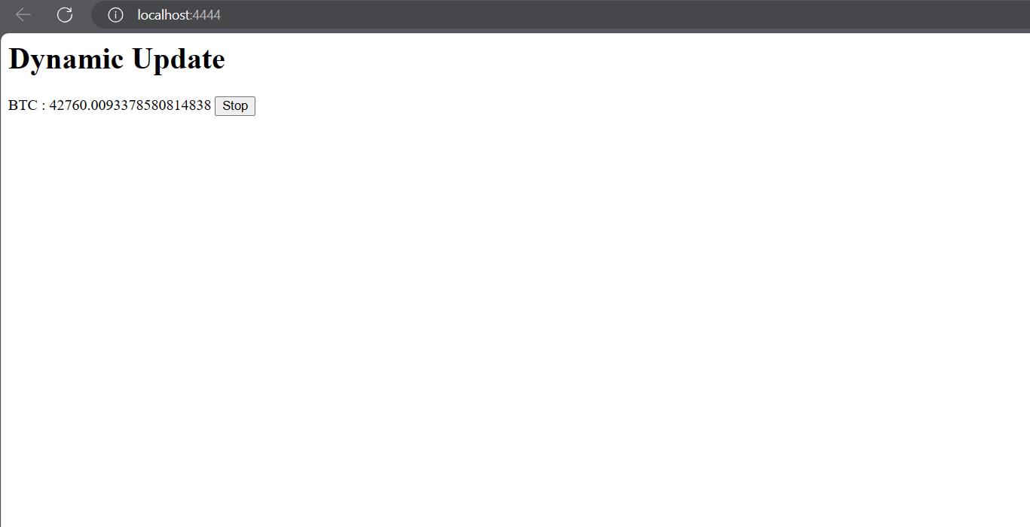
How to access the Website
Anyone can access the website through the link localhost:4444
Overview of
Website

Slide 6
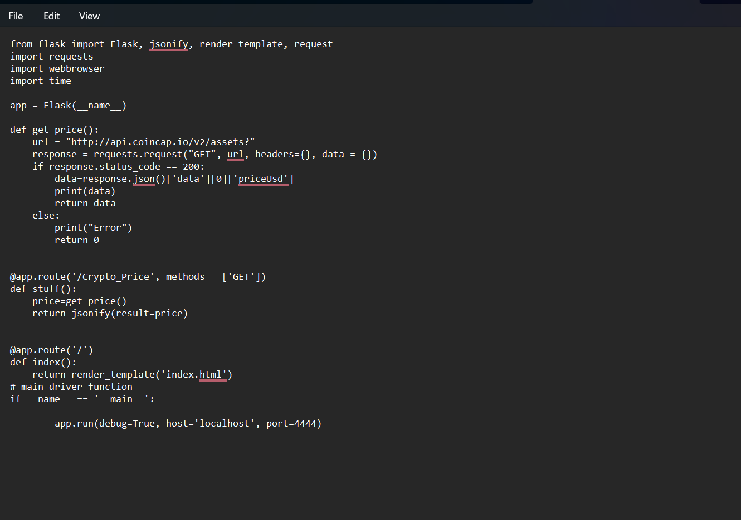
Data Scraping
Code Screenshot for the api
1. Flask Framework Implementation: The script utilizes Flask, a Python web framework, to create a local server, enabling interaction with external APIs.
2. Cryptocurrency Price Retrieval: It integrates with the CoinCap API to fetch real-time cryptocurrency price data. The 'get_price()' function handles the API request, specifically extracting the USD price of a specified cryptocurrency.
3. Server Routing and Responses: - *'/Crypto_price' Route*: This route responds by providing the current cryptocurrency price in a JSON format, facilitating easy consumption of this data. - *'/' Route*: The root route renders an HTML template named 'index.html', potentially displaying fetched cryptocurrency price information or other content.
4. Server Execution: When executed, this script initiates the Flask server locally with debugging enabled ('debug=True'), hosting it on 'localhost' at port '4444', allowing local access to real-time cryptocurrency prices through the specified routes..

Slide 7
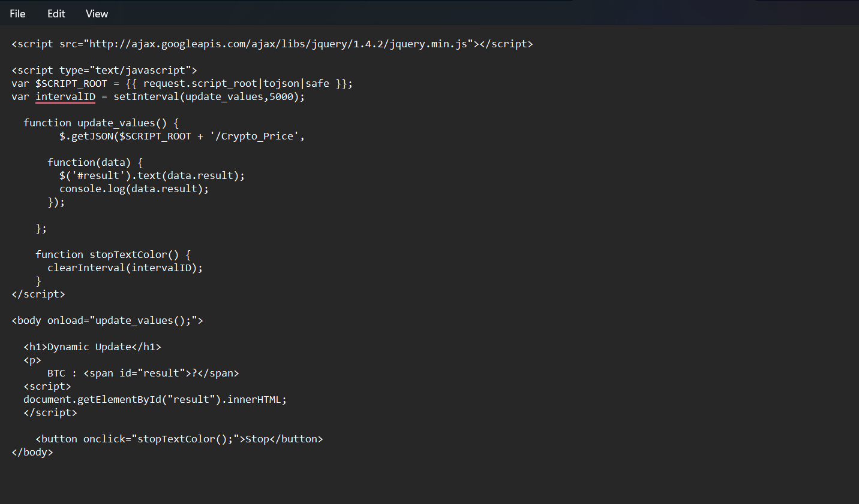
Code Screenshot for Index html
The code starts by including jQuery library from Google's CDN (Content Delivery Network) to leverage its functionalities for easier DOM manipulation and AJAX requests
'update_values()': This function uses AJAX to fetch data from the server at a specified interval (every 5 seconds in this case) and updates the content of an HTML element with the ID 'result' with the received data (presumably cryptocurrency price information).
'stopTextColor()': This function is triggered by a button click and stops the interval, effectively ceasing the automatic updates of cryptocurrency prices.
HTML Structure and Interaction:
On loading the body (<body onload="update_values();">), the update_values() function is immediately called to initiate the process of fetching and displaying live cryptocurrency prices.

Slide 8
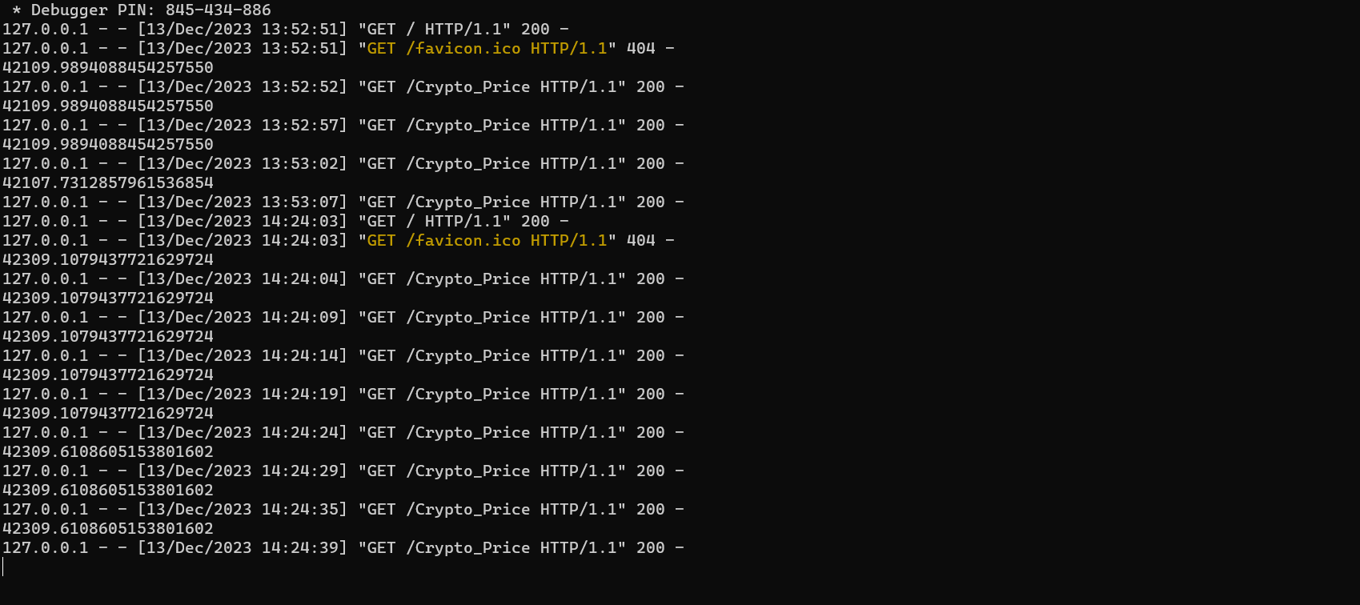
Displaying Crypto rates in Real Time
Here is the screen shot for displaying the real time crypto price data on website.

Slide 9
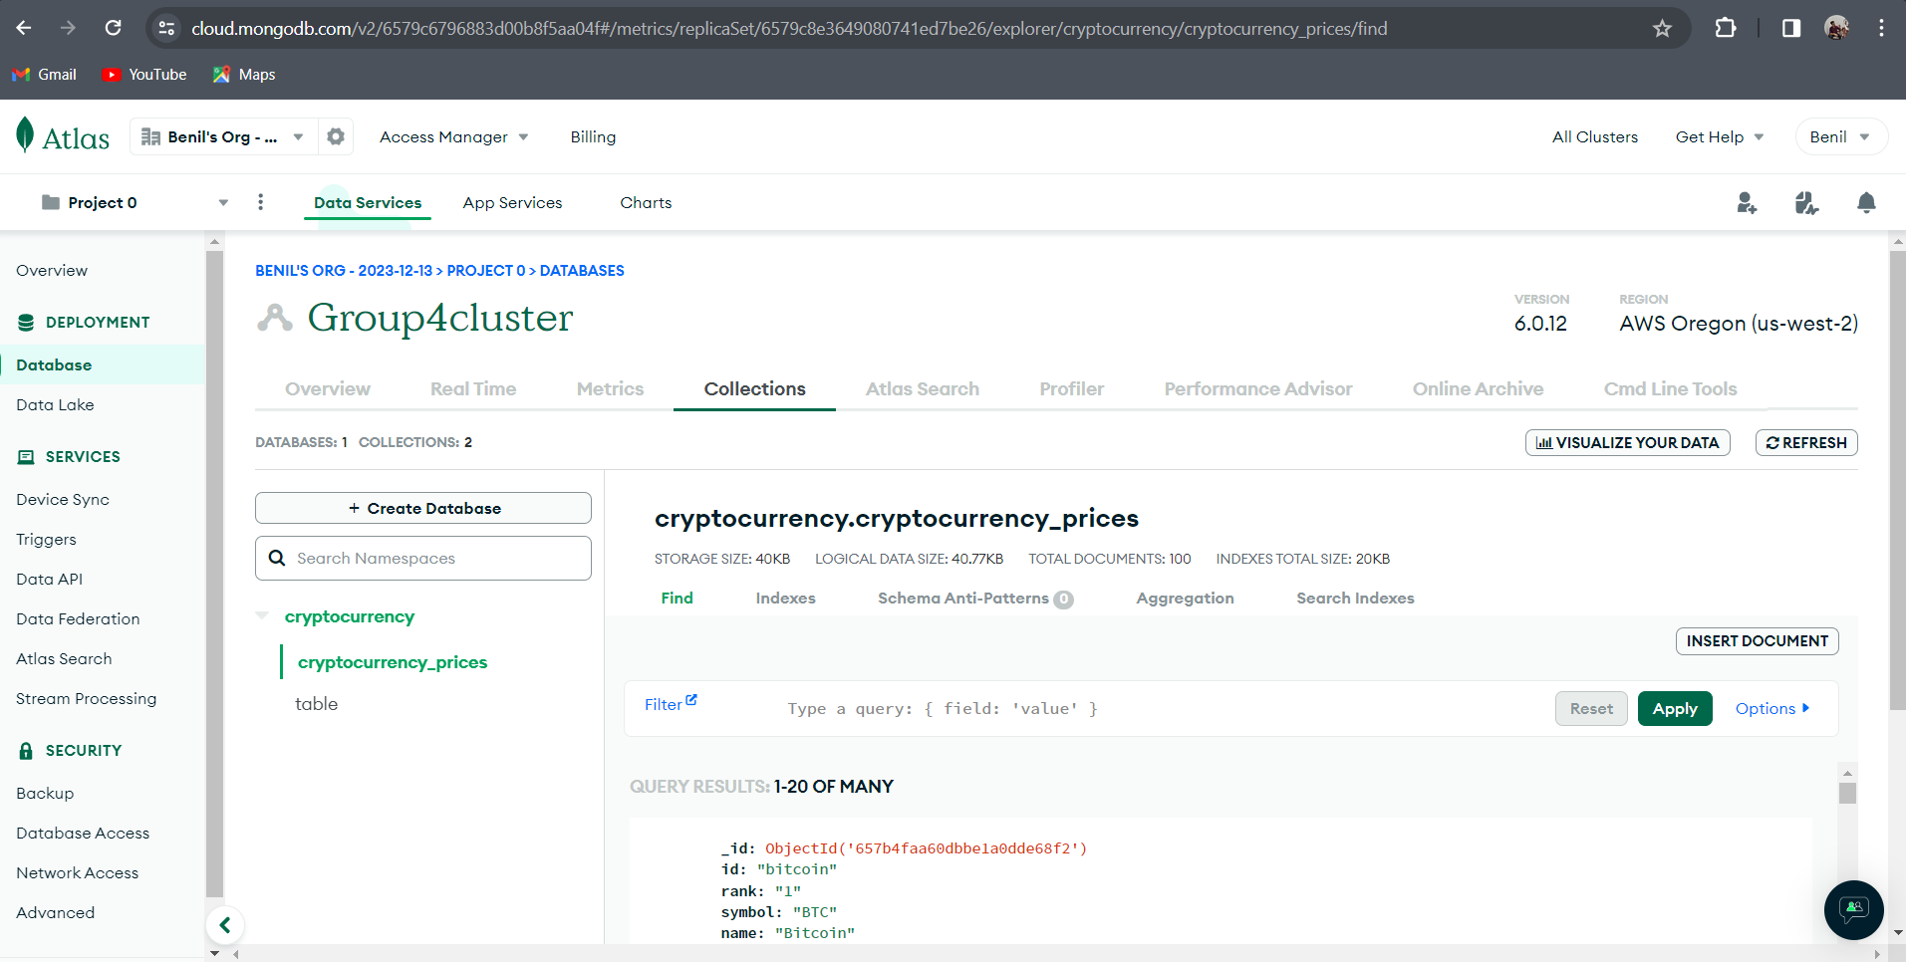
Data Cloud
Mongo DB is the place where
We used to store our data

Slide 10
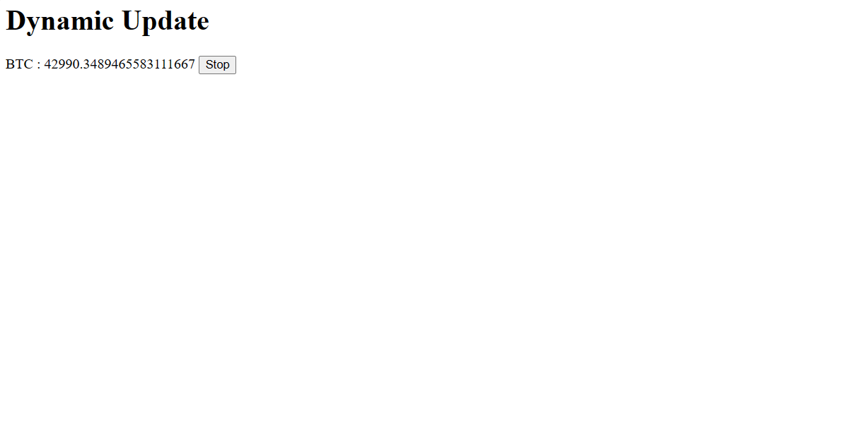
Displaying data
The two screen shot shows the real time changing of crypto prices in the web app

Slide 11
Benefits of the Website
1. Real-Time Data Access: Users can access live cryptocurrency prices instantly, aiding in making informed decisions based on up-to-the-minute market values.
2. Efficient Information Delivery: Utilizing Flask and APIs allows for quick retrieval and dissemination of cryptocurrency prices, offering a streamlined and responsive platform for users.
3. Customizable Display: The project's structure enables customization of how the fetched data is presented, allowing for flexible display options within the HTML template.

Slide 12
Conclusion
This project harnesses Flask, enabling a local server that interacts with an external cryptocurrency API, CoinCap, to retrieve real-time price data. Through concise routing, it offers two main endpoints: '/Crypto_price' for JSON-formatted live price updates and the root route ('/') that renders an 'index.html' template. This integration showcases the power of Flask in creating a server-side application that dynamically fetches and displays up-to-the-minute cryptocurrency prices, demonstrating an efficient utilization of web frameworks for real-time data retrieval and presentation.

Slide 13
REFERENCE
https://youtu.be/B15lmnvOwRsx0?feature=shared

Slide 14
THANK YOU

